Slide 1


What Is The Internet?
Full-Stack Web Development Bootcamp

Slide 2

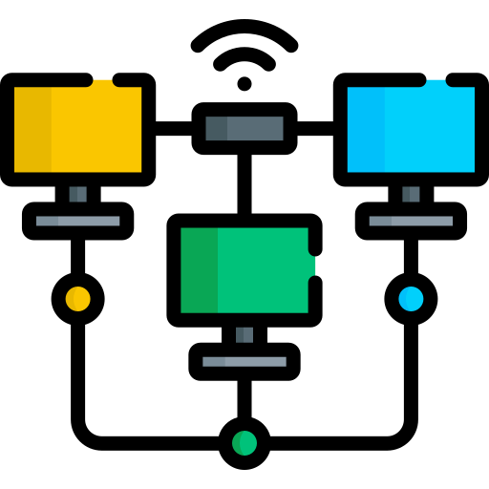
Computers Can Connect
The First Computer Network
The first computer network, ARPANET (Advanced Research Projects Agency Network), was created in 1969 by the United States Department of Defense's ARPA (Advanced Research Projects Agency). It was developed to connect universities and research institutions, allowing them to share data and resources.

Slide 3
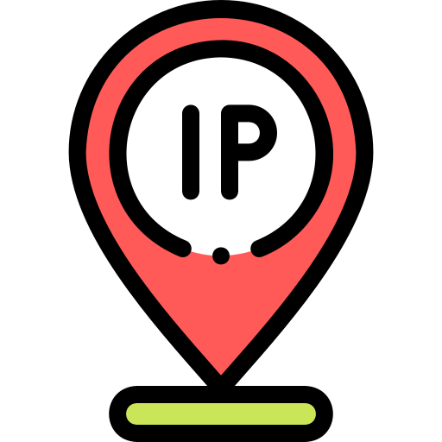
Discovery Of TCP/IP
The Beginning Of The Internet
TCP/IP (Transmission Control Protocol/Internet Protocol) is a suite of communication protocols used to connect devices on the Internet and other computer networks. TCP/IP suite of protocols was discovered in 1970s by Vint Cerf and Bob Kahn.

Slide 4
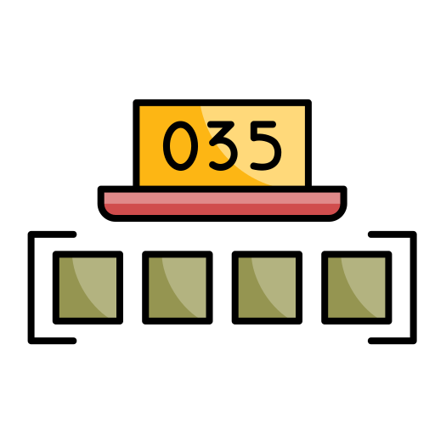
How TCP/IP Works?
TCP (Transmission Control Protocol)
IP (Internet Protocol)
Breaks data into smaller packets, sends them over the network, and ensures they are reassembled in the correct order at the destination.
Handles error-checking and retransmission of lost or corrupted packets to ensure that the data arrives intact.
Each device on a network is assigned an IP address, which identifies it and allows data to be routed correctly.
IP is responsible for finding the best path through the network for data to travel.
Notes:
It’s a combination of two technologies

Slide 5
What IP Address Looks Like?
IPv4 - 192.168.1.1
IPv6 - 2001:0db8:85a3:0000:0000:8a2e:0370:7334
IPv4 addresses are 32-bit numeric addresses written in decimal format, separated by periods (dotted-decimal notation). Each part can range from 0 to 255.
32 bits, supports approximately 4.3 billion unique addresses.
IPv6 addresses are 128-bit alphanumeric addresses written in hexadecimal format, separated by colons. IPv6 allows for a vastly larger address space compared to IPv4.
128 bits, supports about 3.4 × 10³⁸ unique addresses, solving the address exhaustion problem.
Notes:
It’s a combination of two technologies

Slide 6

What Happens When You Send Data?
Computer One – 176.12.156.78
Computer Two – 201.234.12.2
Sends Data
IP – Is Destination
Packets of Data (Typically 1500 bytes)
TCP – Breaks Data Into Packets
Sent Over Network
TCP – Consolidates Packets
IP – Finds Destination
Receives Data

Slide 7
Internet is Network of Networks
195.32.27.18
198.251.27.18
148.35.26.18
201.38.67.18

